Slide 1
THE BRITISH AIRWAYS PROJECT
PREDICTING CUSTOMER BUYING BEHAVIOUR

Slide 2
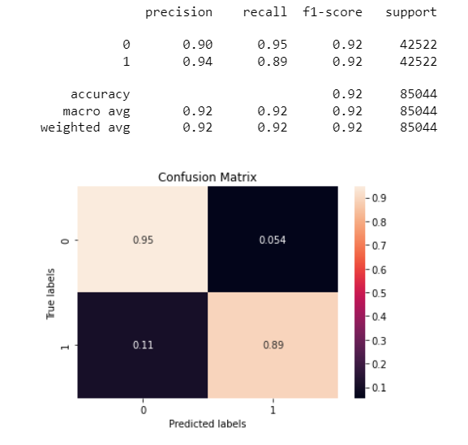
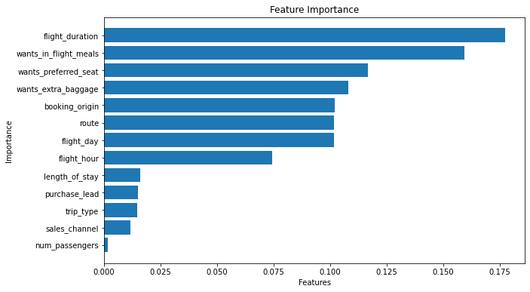
KEY INSIGHTS:
The model demonstrates a strong performance in terms of precision, recall, and f1-score. This suggests that the dataset is highly predictive and can effectively be used to predict the target outcome
Additionally, we observed that among the features considered, flight duration had the most significant impact on bookings, whereas the number of passengers had the least impact

